Slide 1
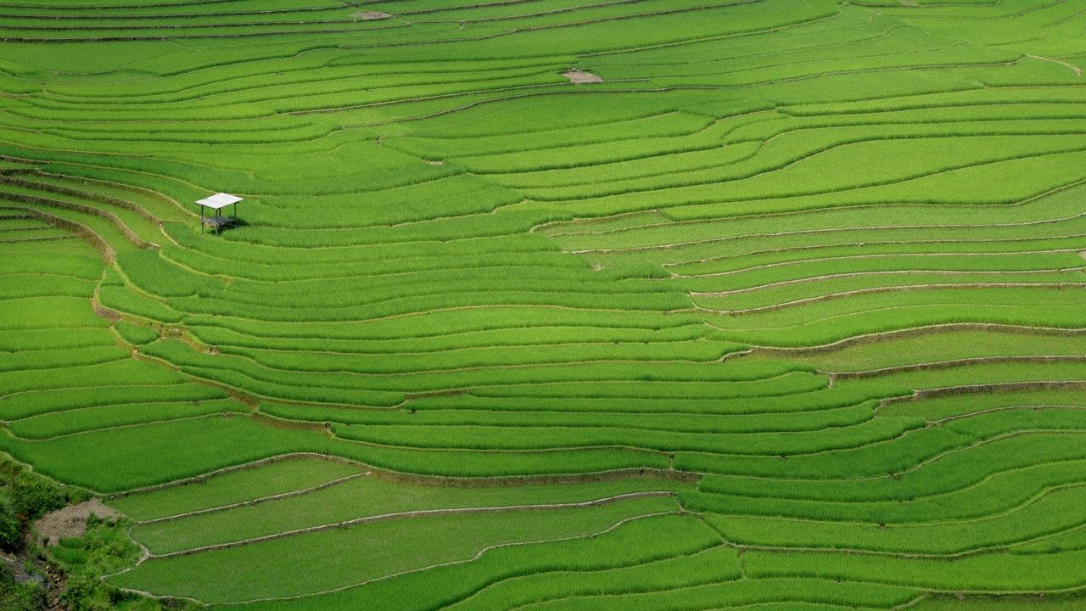
PRECIFARM By Anil Rajpurohit 412043 Arpit Shrivastava 412061 Vaishnavi Patil 412068

Slide 2
Background
In farming maximum production requires certain parameters to be precise and some of them are as follows :
Soil moisture
Soil temperature
Air moisture
Air temperature
UV and light

Slide 3
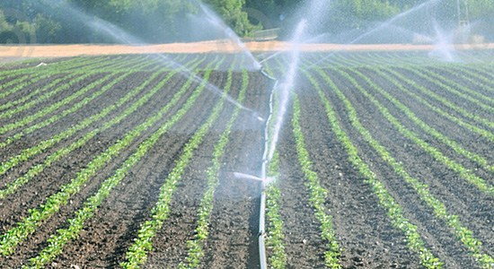
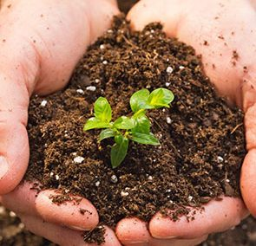

Slide 4
Background
Considering other factors of farming we know that wastage is something which comes into highlight not only water but also fertilizers.
Covering the range and maintaining the precision are two factors which need to go hand in hand.

Slide 5
Vision
To precisely monitor the parameters and build a robust interface in order to increase the overall efficiency of agriculture and automize the same.
To commercialize the project into a product for future development in the agriculture industry.

Slide 6

Integrated wired and wireless IOT solution for Precision Agriculture

Slide 7
Data Generation – Various sensors at the node.
Data Transfer – RFM96W.
Data Storage – Once collected at the base station it is converted to a format suitable to transfer to the cloud and then the data is stored in the Cloud.
Data Usage – In the cloud we store the data and this data is stored in a particular manner which is further given to the user interface.

Slide 8
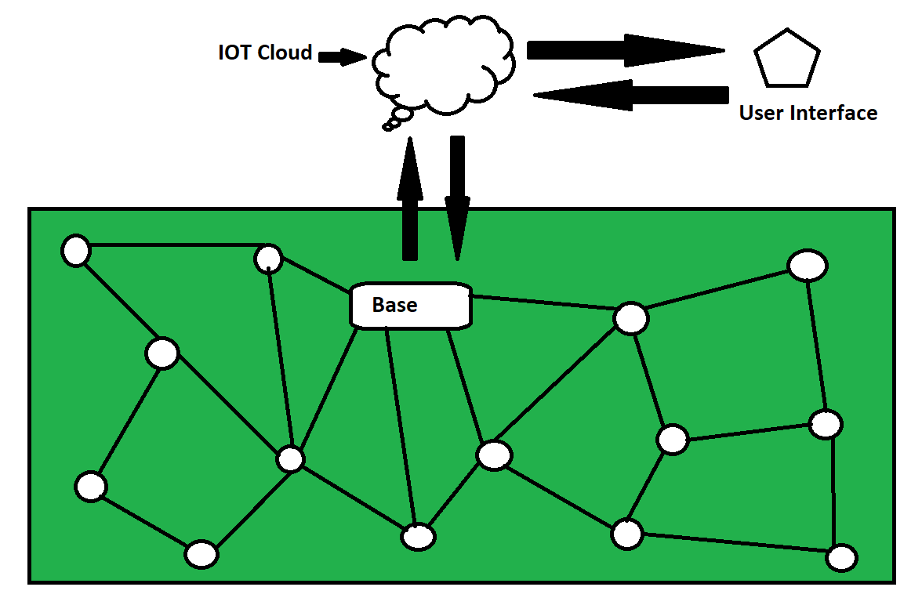

Slide 9
Node Information
Various air , soil , EC and UV rays sensors. Eg. SM150T , mec-10 , RHT03
Transceiver RFM96W
Microcontroller ATmega328P
Battery

Slide 10
Hardware and Cloud
Power supply module
Sensor interface
Battery
Wifi ESP8266_12E
SIM 800 GSM module
The Django framework based cloud is used for data management.

Slide 11
User Interface
There will be a website where in we can see all the data properly represented along with analysis including graphs, pie charts etc.
The user will decide the further action according to the data received.

Slide 12

Innovation
Why Django ?
The framework will be
Secure
Modular
Dynamic
Python based
Why WSN?
Covers the whole range without wires.
There is a proper precision attained once we get data about all the locations on the field.

Slide 13
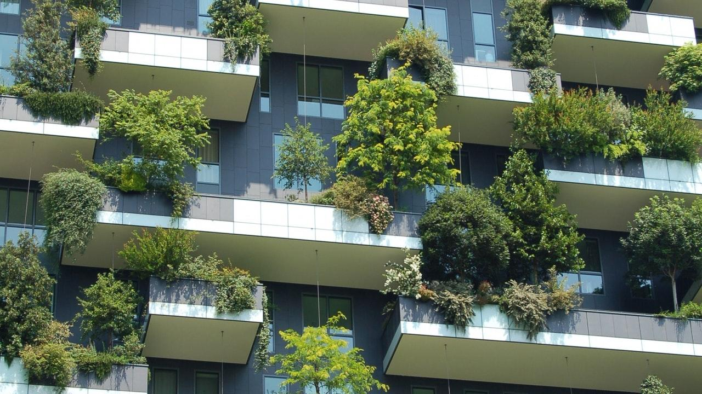
Overall Remedy
Now having a look at the total module we get to know that the module we have made , not only gives us the data, It generates data, transfers data , stores data and uses the same for a better action as well and so this is an overall remedy.

Slide 14

Future Scope
Solar Energy can be attached to the product in order to make it self sustainable.
Increasing Efficiency.
Getting more parameters.
Improvised data analysis in the user interface.

Slide 15
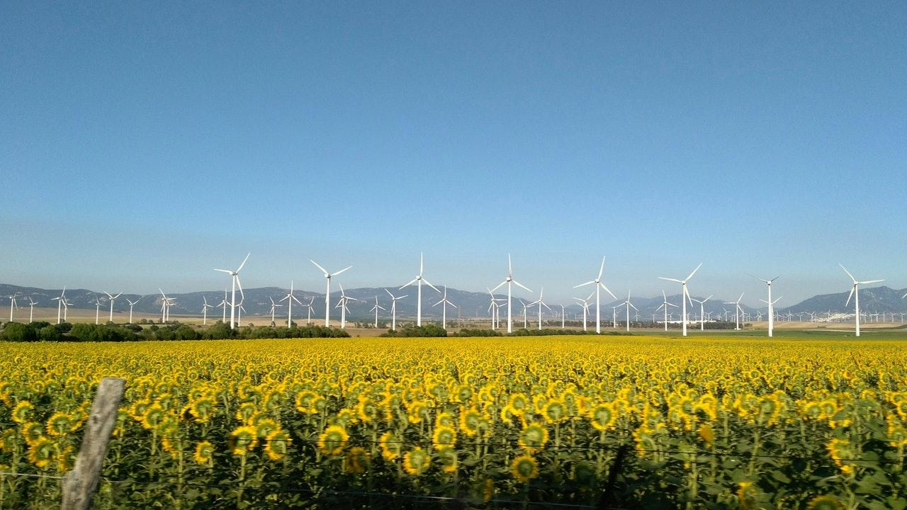
Conclusion
Agriculture in today’s world holds the utmost importance and working towards its precision is our duty.
This is a small attempt by us where we have applied our engineering knowledge practically for a better green life tomorrow and a more happy farmer today.

Slide 16
Thank You
Any Questions?

